Slide 1
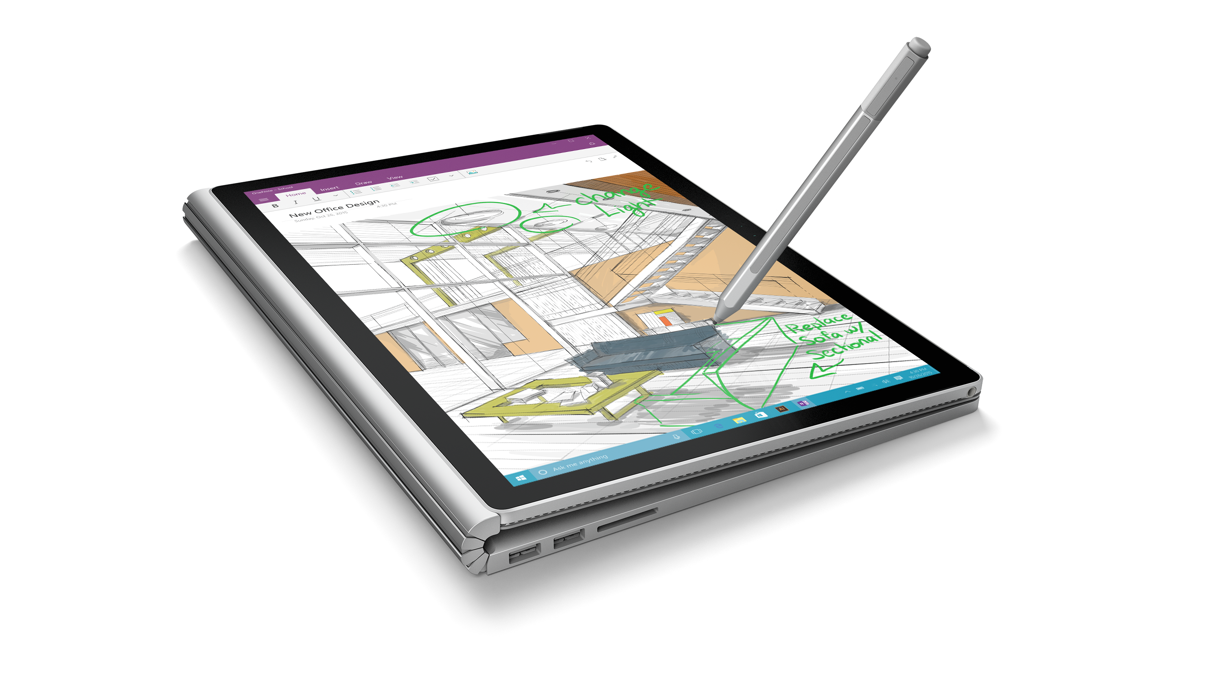
Windows 10 Developer Workshop
Larry Lieberman
Shen Chauhan

Slide 2
Agenda
Strategic and tactical details
Event preparation & setup
Content
Details
Objectives of each module
Presentation recommendations
Q&A
NOTE
There are somethings listed specifically as ‘optional’
Content is _mostly_ functionally complete, but still some work in progress
Regardless PLEASE PROVIDE FEEDBACK

Slide 3
Details: Objectives
Reaching out to developers who currently build for, or have built for Windows (the ‘friendlies’)
Follow through on our UWP developer story; Demonstrate the reality of what developers can achieve
Deeper engagement and investment through more interaction
Provide baseline education for delivering reasonable UWP app
Not objectives
Porting
Bridges (H2)

Slide 4
Details: Locations & Time table
Oct 29 | Belgium, Moscow
Nov 06 | Mumbai, Mexico City
Nov 12 | Rome
Nov 18 | Sao Paulo
Nov 19 | Netherlands
Nov 20 | Tokyo
Nov 21 | Beijing
Nov 25 | Vancouver, Istanbul
Nov 28 | Shanghai, Seoul
Dec 03 | Tel Aviv
Dec 09 | Dubai
Dec 10 | Warsaw
+
Nov 10 – Dec 15 | 12 US Win 10 Events

Slide 5
Details: Preparation
Clone the repo on GitHub (https://github.com/Windows-Readiness/WinDevWorkshop)
1 proctor per 20 attendees
Instructor & proctor should all review the labs prior to the event
Software requirements
Windows 10 Pro or higher
VS 2015
Windows 10 SDK
Windows 10 Emulators (require SLAT)
Instructor Hardware
IoT (Optional)
Stylus

Slide 6
Delivery *NOTE*
PRACTICE
Notes:
This is pretty different from the ‘camps’ we’ve run in the past.
We believe it will drive deeper impact… walking the audience through the code, while they themselves code, means they get the tactile experience of actually making the code work, and they should get invested in it.
… BUT… it means more work for you!!
The labs were written for self-use… not demo steps
Thus, you have to go through them to figure out the steps you’re going to take in your presentation
We have very tight timeframes in this workshop… you’re not going to have ANY time to read in real time
NO WAY YOU CAN WING THIS

Slide 7
Content: Day Recommended Agenda
09:30 – 10:00 | Setup
10:00 – 11:00 | 1. Intro
11:00 – 12:00 | 2. Adaptive UI
12:00 – 12:30 | 3. Tiles
12:30 – 01:30 | *Lunch*
13:30 – 14:30 | 4. Edge / Web
14:30 – 15:30 | 5. Cloud
15:30 – 16:00 | *Break*
16:00 – 17:00 | 6. MPC / (opt: App Svcs)
17:00 – 17:30 | 7. Store / $$

Slide 8
Module 1 | Introduction to Win 10 Dev | 60
Lecture
13 slides / 15 minutes (really just 6 intro slides)
2 labs
Hello UWP (inc. optional IOT deploy)
Getting started
Hello UWP across device
Hello UWP in Blend (opt)
Page navigation and back
Objectives
Lay the foundation on the purpose of the UWP and how it solves an enormous problem
Leverage page nav to demonstrate how one type of functionality can manifest different device types

Slide 9
Module 2 | Adaptive UI | 60
Lecture
15 slides / 15 minutes
1 demo, (calculator)
1 lab (building adaptive UI)
Evolve a fixed UI to adaptive (basic VSM)
Leverage RelativePanel
Build alternate XAML views
Objectives
Introduce adaptive UI principles, scaling, effective pixels, basic design techniques, Visual State Manager, etc.
Walk through how to build a page that adapts to different screen sizes and resolutions

Slide 10
Module 3 | Live Tiles & Notifications | 30
Lecture
15 slides / 10 minutes
Lab
Customize default tile
Create Adaptive tile
Interactive Toast (You might need to cut this one)
Objectives
Tile basics
Adaptive Template
Toast basics
Interactive Toasts
Note
Tile assets in “assets” folder

Slide 11
Module 4 | Edge & Web Apps | 60
Lecture
25 slides / 20 min
Lab
Web View
Hosted Web Apps
ManifoldJS (Optional)
Objectives
WORK IN PROGRESS
Note
Lab currently has you publishing an Azure Website; we’re changing

Slide 12
Module 5 | Cloud Services | 60
Lecture
11 slides / 15 min
Lab
Getting started with AAS
Enable Auth, and connect to cloud
Enable offline sync
Objectives
Provide rich overview of Azure offerings for UWP apps
Demonstrate workflow to implement auth and sync
Notes
We’ve created the backend for you, (you don’t do task 1)
This one really requires practice
Notes:
While there are a lot of steps to this one; we think its REALLY important, because we think there is a key platform differentiator in the UWP / Azure connection

Slide 13
Note on Mod 5
Note that this lab involves the attendees connecting to an existing Azure App Service Mobile App service. This service requires authentication, so a custom Azure Active Directory has been set up with 500 users created in it, names user1@uwphols.onmicrosoft.com through user499@uwphols.onmicrosoft.com, password Password1 through Password499 respectively. The username token is stored against every item stored in the cloud database, so in principle, every user will enjoy separation of their data from everyone else’s. Also, a webjob runs every night to clear down data stored in the backend database.
However, people taking the lab call a webpage to find out which username/password to use but all that does is round-robin the available users. Therefore, there is a very slim chance that if more than 500 people take the lab in any one day, or people just choose a username at random, then they may find that two or more people end up using the same username and the ToDo items they create will be merged. For this reason, please advise folks to keep it clean when creating ToDo items!

Slide 14
Module 6 | MPC | 60 (or 30 if no Cortana)
Lecture
21 slides / 20 min
Demo
Option to demo Windows Hello
Lab
Launching apps with Speech through Cortana
Working with Ink Input
Objectives
Describe ‘MPC’ all up
Windows Hello / Passport
Describe speech developer features (Command, Reco, Synth)
Describe Ink platform
Notes
Lab 1 (Speech through Cortana) will be optional based on your region

Slide 15
Module 6 b | App Services | 30 (only if no Cortana)
Lecture
13 slides / 20 min
Lab
Create/register app service
Call the service in background from another app
Pass data back and forth
Debug
Objective
Provide the (very) quick run through of app service functionality available in UWP
Note
We’re working on refactoring the lab to make it more accomplishable in time
One of the more complicated labs in terms of code/XML to enter

Slide 16
Module 7 | Store & Monetization | 30
Lecture
9 slides / 15 min
Lab
Integrating Interstitial Ads
Objectives
Provide the lab around how to publish your app

Slide 17
Questions!

